Slide 1
The real Rioja
Abel Mendoza and Maite Fernández Wines
Presentation credit to Cristina Fernandez-Crespo

Slide 2
A PRIVILEGED LOCATION
The Rioja PDO (Protected Designation of Origin) region, located in northern Spain and straddling both sides of the River Ebro, comprises more than 60,000 hectares of vineyards that enjoy special properties due to their strategic location between the Atlantic and the Mediterranean and the geographical features of the area.
The county of Sonsierra is located in the very heart of the Rioja PDO region. Bordered by the Cantabrian Mountains to the north and the River Ebro to the south, throughout history it has enjoyed a reputation for the exceptional quality of its wines. Sonsierra’s unique microclimate and terroir combine to give its grapes a very special character.

Slide 3
MICROCLIMATE
EXCEPTIONAL CONDITIONS
The Cantabrian Mountains to the north and the River Ebro to the south of our vineyards create a unique microclimate that is perfect for vine-growing.
Mild temperatures throughout the year and moderate rainfall.
Daytime/night-time temperature differential.
Winds are present 80% of the time, ensuring excellent aeration of the vines and preventing the development of diseases.
The south-facing aspect and the mild slope of the vineyards expose the vines to plenty of sunlight.
There is a wide variety of different terrain: from the foothills of the Cantabrian Mountains at an altitude of 770 metres, to the rolling terraces of the lowlands near the River Ebro, at an altitude of just 420 metres.
La Sierra: the highest vineyards (525- 770 m) and the freshest, wettest region.
La Comarca: intermediate zone (485- 525 m), with moderate temperatures and rainfall.
La Ribera: the lowest area (420-485 m) and also the hottest and driest.

Slide 4
VINEYARDS

Slide 5
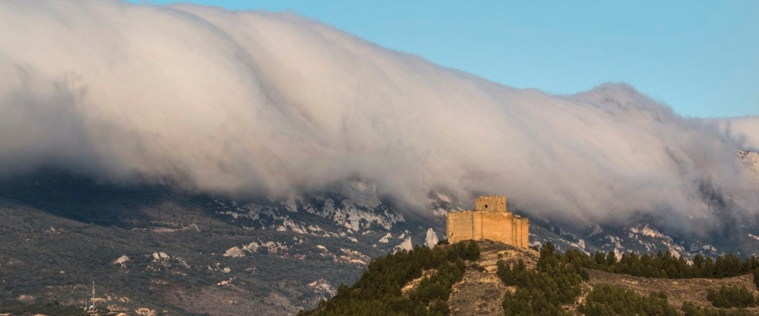
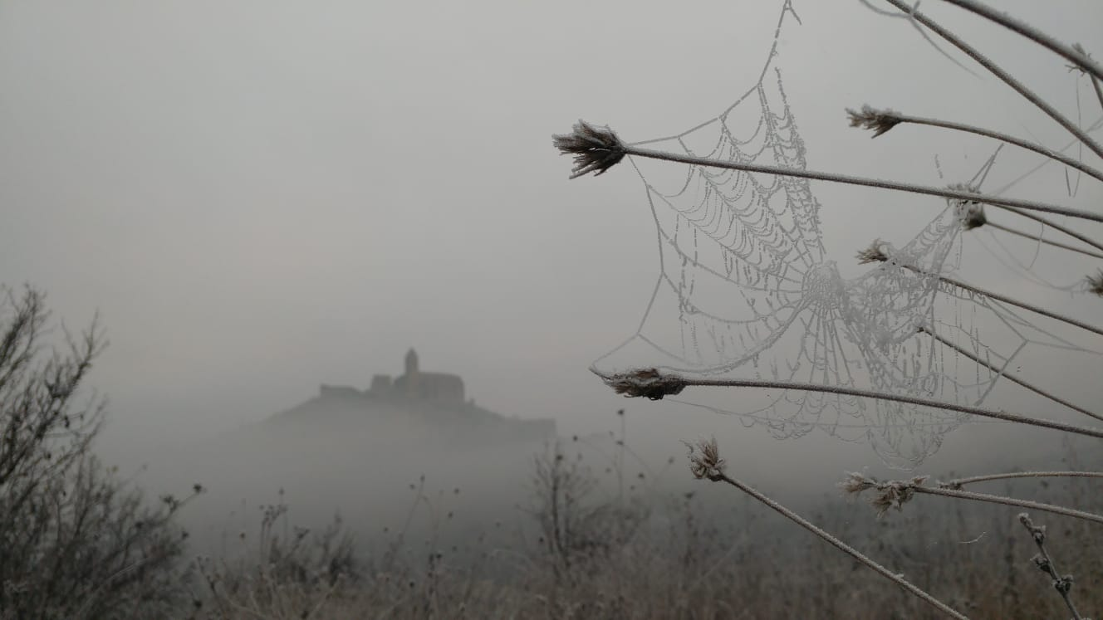
FOEHN EFFECT
Causes the change from wet and cold conditions one side of a mountain, to warmer and drier conditions on the other side.
FOG
Vineyards on the riverside are affected by misty mornings. Fog makes the area stay cooler, and the sunlight cannot penetrate through to help ripen grapes during the day. At the same time, fog at night helps grapes keep their acidity and freshness.

Slide 6

TERROIR
The vines grow here have average ages ranging from 20 to 130 years old.
Poor soils with little organic material help limit production levels, thereby increasing the quality of the grape clusters.
Variety of soils, generally rich in limestone:
Sand
Silt
Clay
Gravas soils
Calcareous clay
These provide the perfect medium for the Tempranillo and the other indigenous varieties of Rioja.

Slide 7
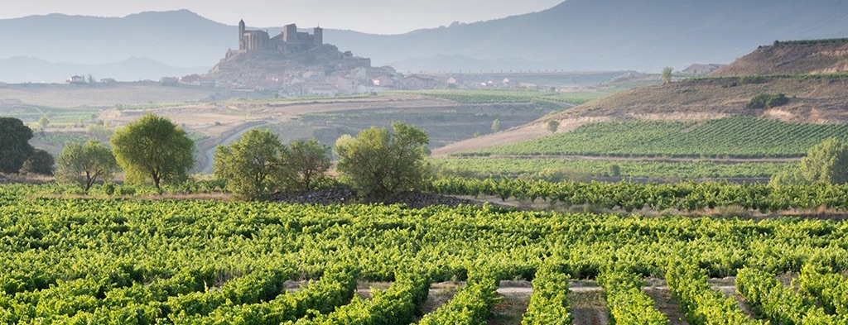
SAN VICENTE DE LA SONSIERRA
In San Vicente de la Sonsierra, a small village with a population of 1027 inhabitants, there are currently forty wineries of varying sizes and output, of which 32 have a bottling license. With 1,800 hectares recognized by the Control Board of the Rioja “Qualified” Designation of Origin producing around 12,000,000 liters of wine per year.

Slide 8
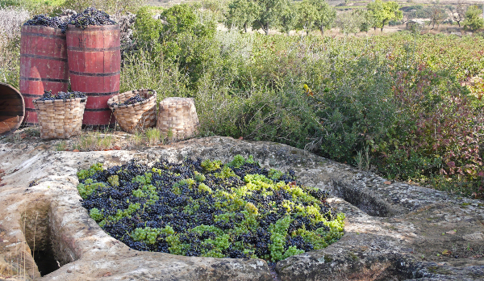
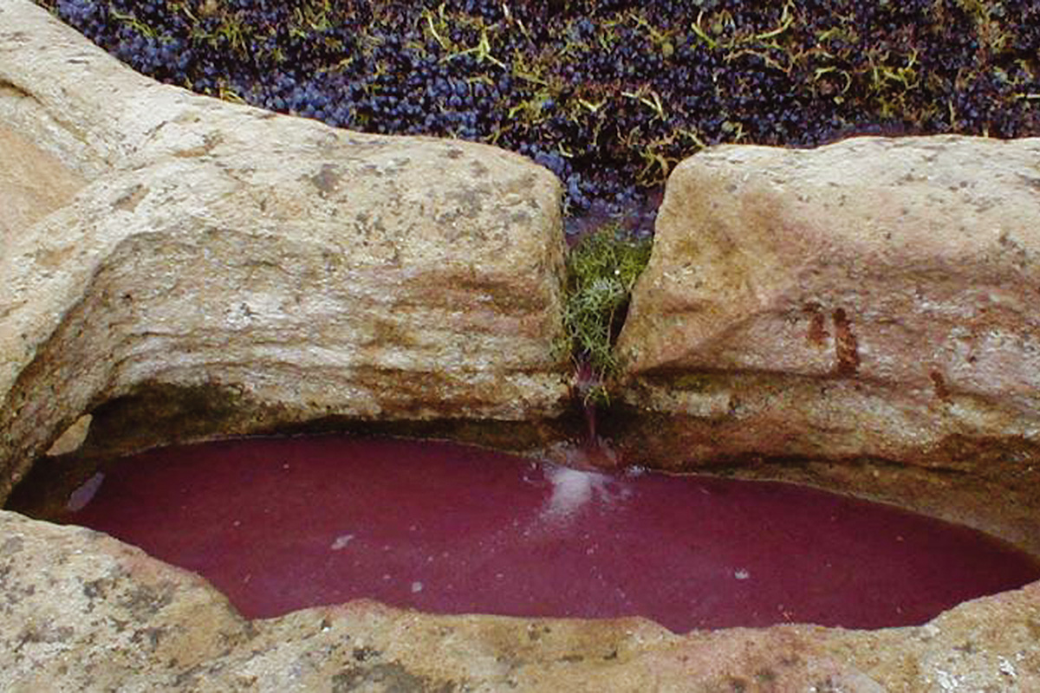
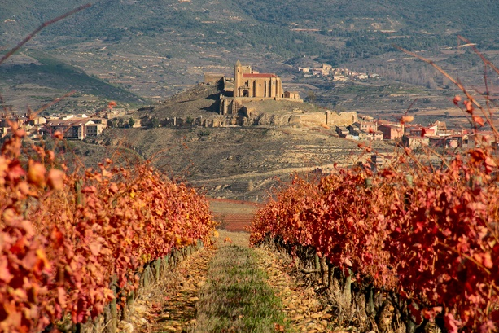
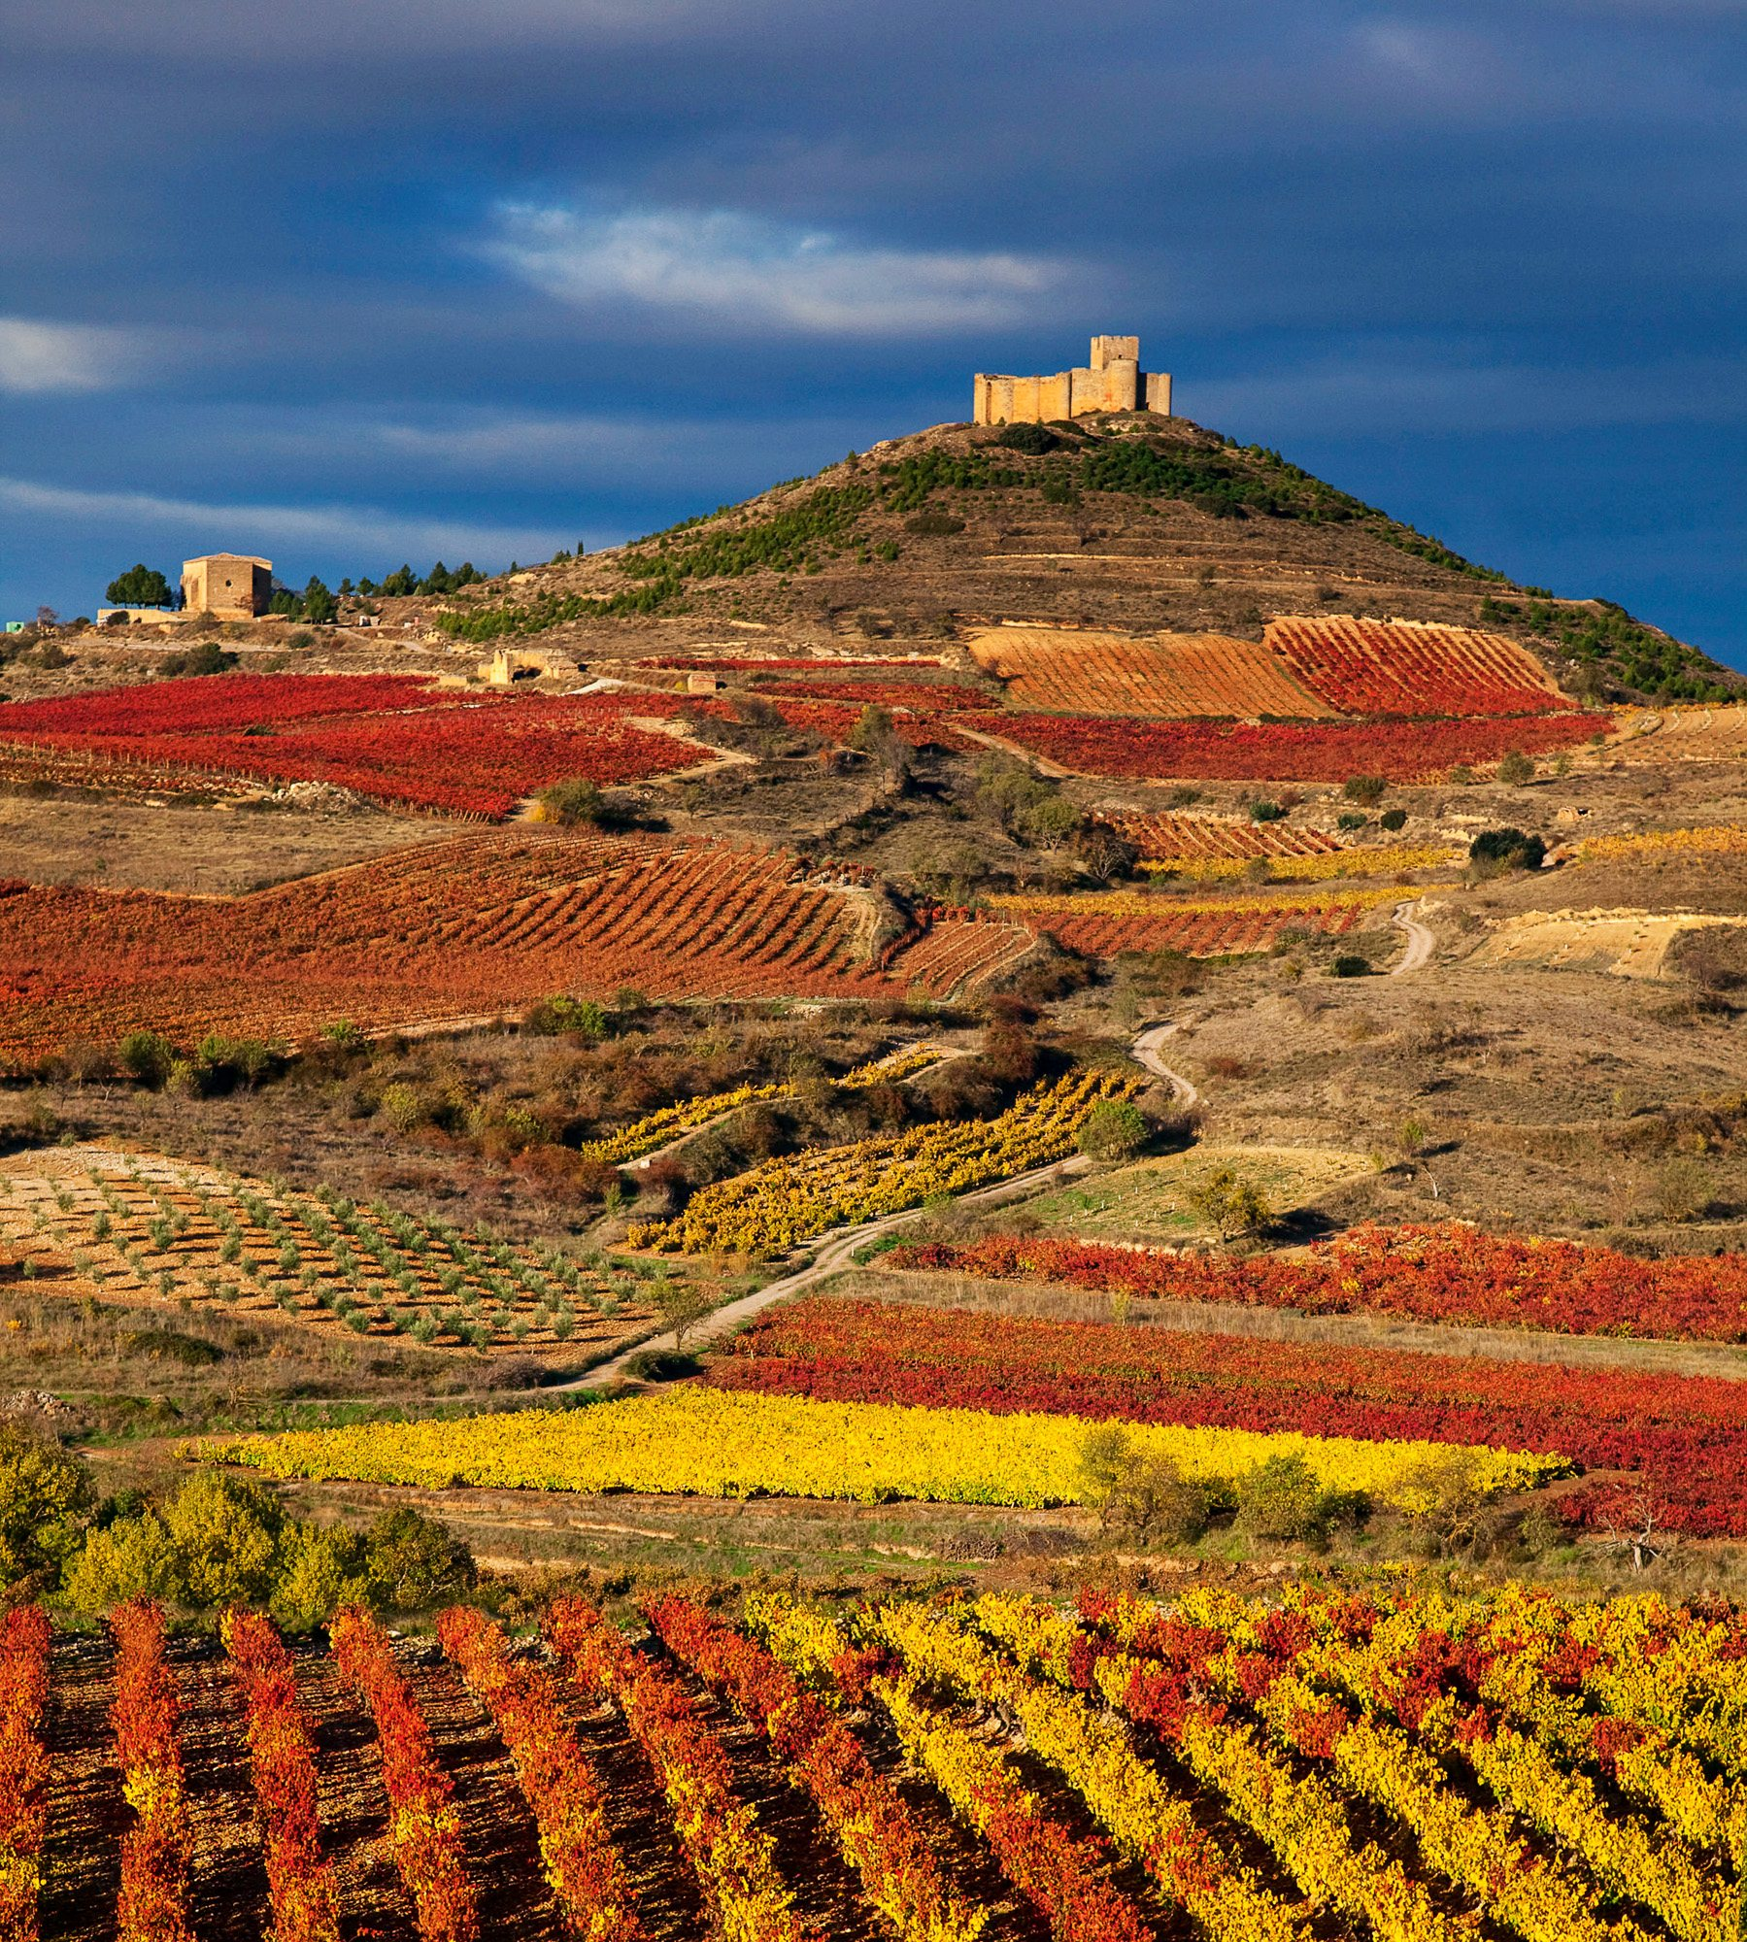
A landscape shaped by wine culturE
Lagares, wine presses carved in the limestone. These are spread out all over the surrounding area, between vineyards. La Sonsierra has the greatest concentration of these structures in the world, with over 200 examples in this area alone.
The castle of San Vicente de la Sonsierra, in the old Kingdom of Navarra, was built around 1170 and is the largest fortress in the vicinity of the River Ebro.
Cellars and stone wine presses from the 11th Century have been found in the fortress thanks to recent archeological campaigns.

Slide 9
MODERN VITICULTURE
France was hit really hard by the arrival of powdery mildew in the 1840's, and devastated again by phylloxera in the late 1860’s. Desperate not to lose their wine entirely, Bordeaux winemakers travelled to Rioja and invested heavily in the region in order to continue making wine until a solution could be found, bringing with them their winemaking techniques.
Guardaviñas: traditional rustic constructions (19th century) such as shelters that survive the passage of time dotting the roads and vineyards.

Slide 10
ABEL & MAITE
A DIFFERENT APPROACH TO RIOJA WINEMAKING
For them, intervention in the winery is important to make the wine, but the character of the land and its climate must be reflected in the dozen or so wines they produce annually.

Slide 11
Abel and Maite cultivate a total of 20 hectares in 35 different plots all located in la Sonsierra: in San Vicente, Labastida and Ábalos. They produce a maximum average of 70.000 bottles/year.
The croplands are rugged and varied in composition, alternating clay soils, marls and fine sandstones.
VARIETIES
They have planted red varieties, with an average age of 35 years, like Tempranillo (16 ha), Graciano (0.6 ha) and Garnacha (0.2 ha).
White varieties, with an average of 26 years old, like Malvasía, Viura, Torrontés, Garnacha Blanca and Tempranillo Blanco occupy an extension of 1,2 ha.
The planting density and the pruning system generates yields of 5,500 kg / ha.
The geographical position of its vineyards allow them to enjoy an ideal climate to obtain excellent grapes: rainfall of 480 mm per year and 2,100 hours of sunshine per year, the average temperature of the vegetative cycle is 16ºC and the day-night interval in the ripening period is 28 to 12ºC.

Slide 12
FIGHTING CLASSIC RIOJA LABELLING TERMS
Abel (grape-grower) and Maite (oenologist) are mavericks in a region where most wines are categorised by the amount of time they do or don't expend in oak.
They take a Burgundian approach to terroir, fermenting their plots separately and treating each with care and adapting to its particularities.
Their wines do not follow the classic Rioja aging classification and therefore these terms will not appear on the labels.

Slide 13
RESCUING INDIGENOUS GRAPES
Over the years their grape-growing aim was to focus on recovering indigenous white varieties, some of them achieved through vine grafting techniques made from pre-phylloxera vines. Varieties that 25 years ago were practically forgotten and lost.
Some of them were eventually recognised by the DOCa (2009, Tempranillo Blanco and Torrontés) along other international varieties which they do not grow. Nowadays all the varieties they grow are accepted under the Rioja labelling law.
Some of them are still rare. Abel Mendoza Torrontés has a unique character as it is one of the few - if not the only - single varietal Torrontés in Rioja.

Slide 14
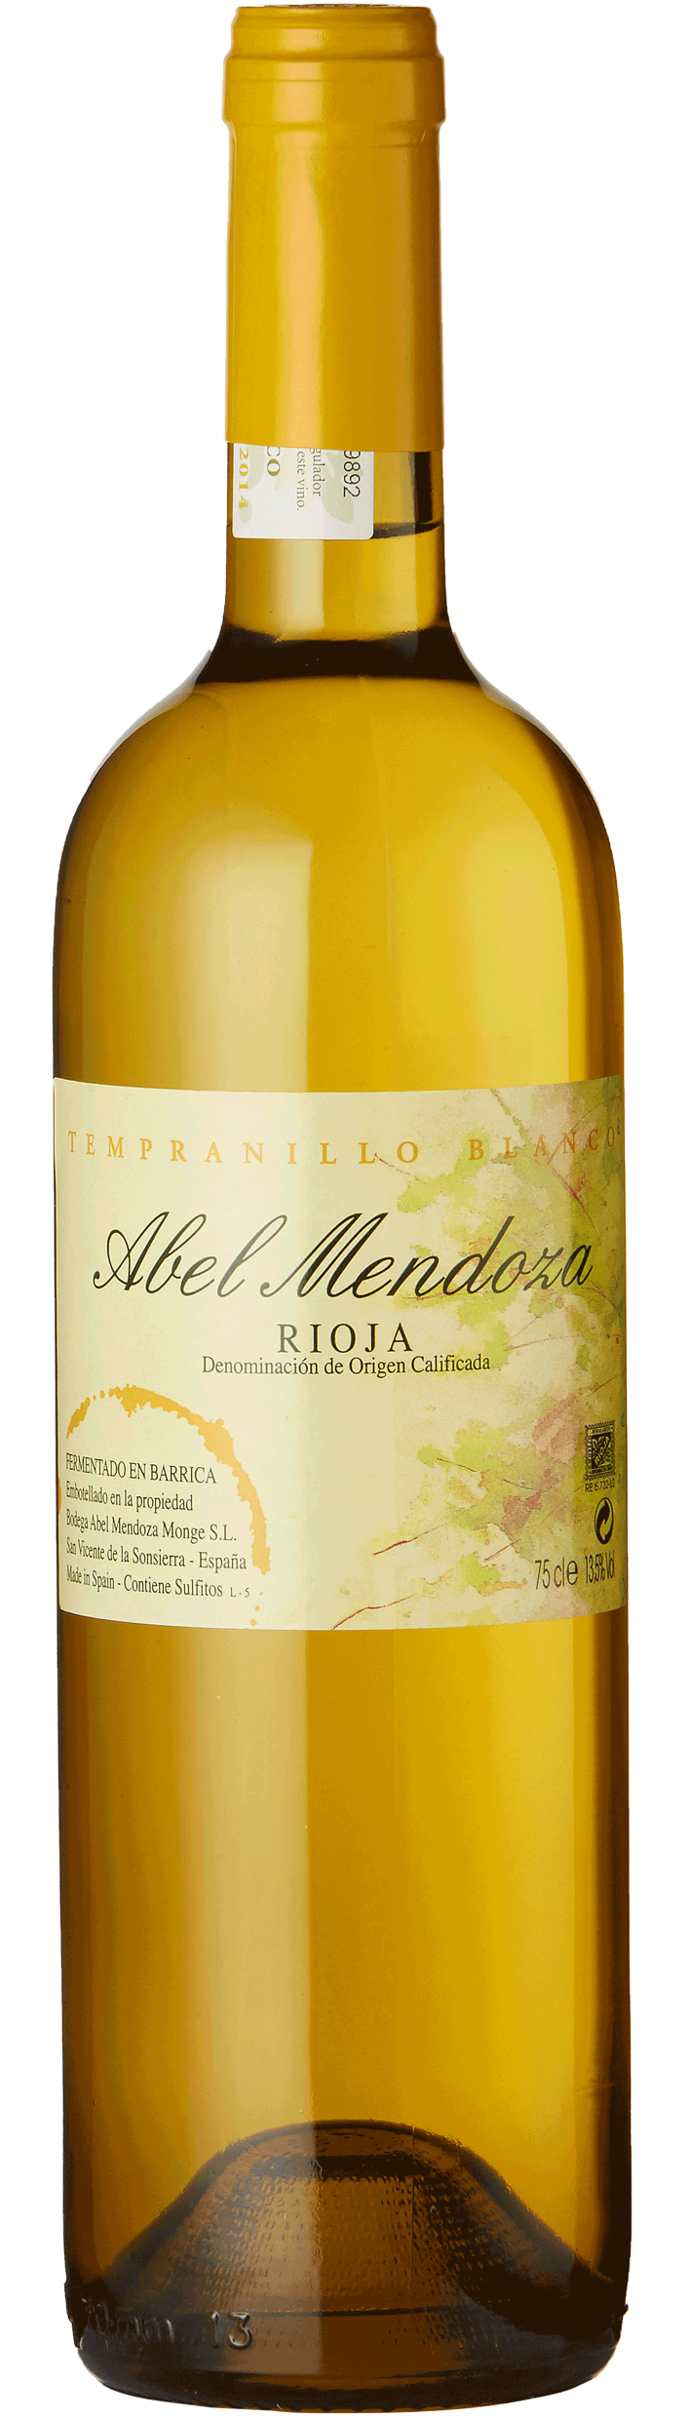
ABEL MENDOZA TEMPRANILLO BLANCO
Tempranillo Blanco is a mutation of Tempranillo Tinto. Abel found these mutations in another Rioja vineyard, took cuttings and grafted them onto American rootstock in his chosen parcels.
The vineyard parcels are a mix of clay and caliche soils. The parcels are picked separately based on sugar and vine health. Sugar level is important at harvest, but phenolics are vital in the decision as well. Correct ripeness at picking is important. Tempranillo Blanco is a small grape, so it ripens earlier. Tempranillo is derived from the word “Temprano” (meaning “early”), and is usually the first varietal harvested.
All Abel Mendoza white wines are handled in the same manner. The fruit is sorted and then pressed in a pneumatic press. The juice then goes into tank for a brief settling period. After one day, the juice is racked off into new French oak barrels for fermentation.
After fermentation, the wines will stay in the barrels for 5 - 6 months. There is no set time, but rather the decision is made on taste. Abel and Maite want fruit and soft wood integration on the whites. Batonnage is done every 2 - 3 days. After the barrel maturation, the wines are blended into a tank, stabilised and then bottled.

Slide 15
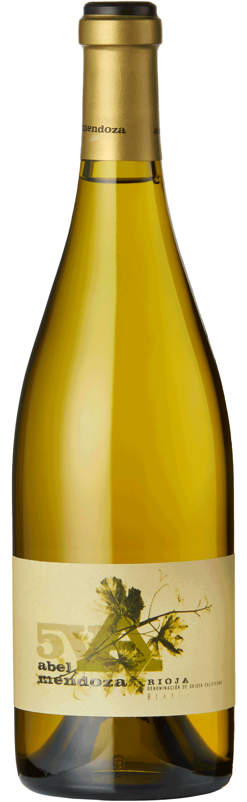
ABEL MENDOZA 5V
All varieties used by Abel Mendoza are indigineous to Rioja. In 2009, they decided to do a blend of all five white varieties they grew. The first blend was 20% of each, but this was later adjusted to a taste-based decision. The wine is called 5V because at the time, Tempranillo Blanco and Torrontés were not allowed to be put on the label by the Consejo Regulador of Rioja.
When creating the blend, the proportions are decided based on quality and quantity. Their philosophy is not one of taking the best fruit for the blend or for the single-varietals. Rather, the decision is made on desired characteristics and what they are looking to show in the wines. Structure, acid, fruit, aromatics etc.
Sometimes the blend is done at the juice stage (if the vintage has allowed for similar ripening times) and sometimes the blend is done after fermentation. Similar to the single-varietals, the wine spends 5 - 6 months in new French oak barrels.

Slide 16
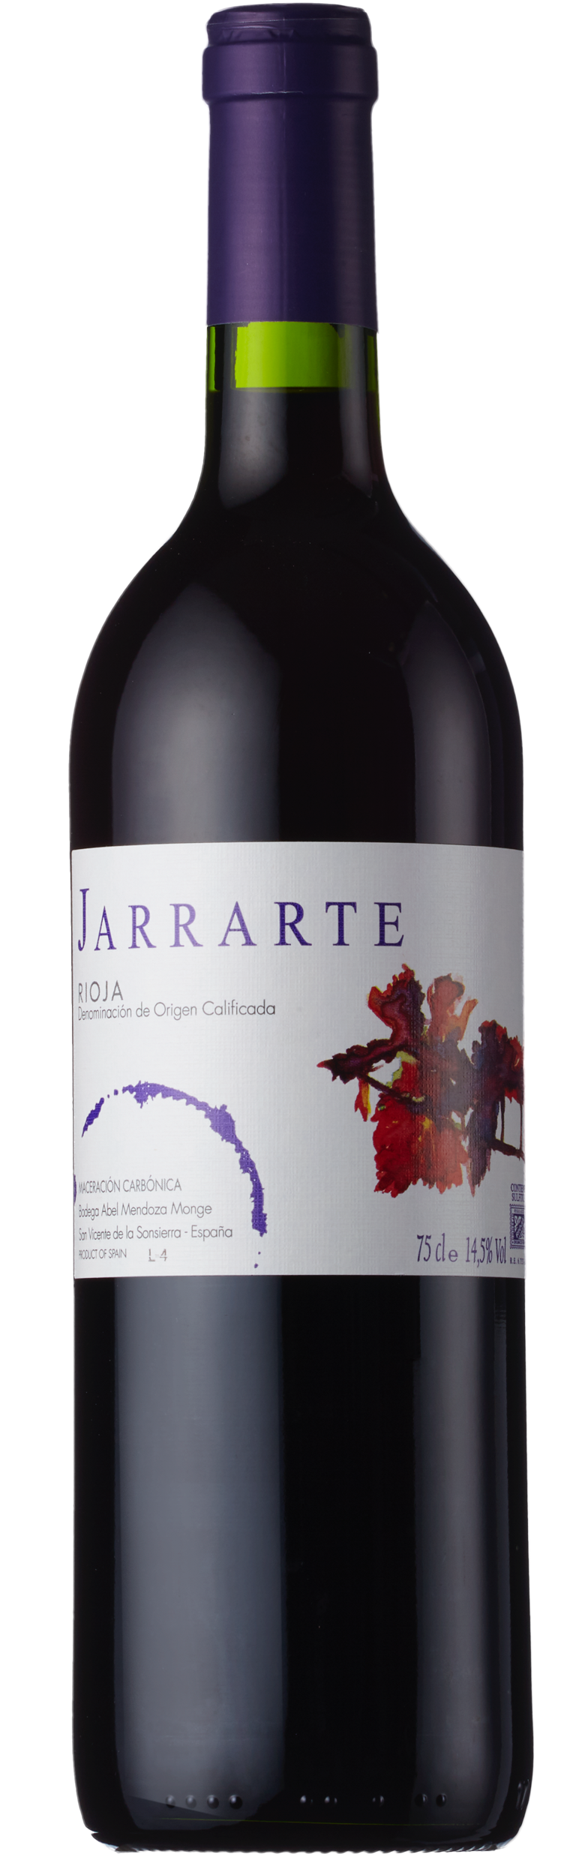
JARRARTE MACERACION CARBÓNICA
“Jarrarte” is the name of an area next to the river that flows through San Vicente de la Sonsierra in Rioja. The area once belonged to the kingdom of Navarre, and the word has roots in the Basque language. “Arte” (between) and “Jarra” (stones). This is an homage to the soils of the region which are very stony and alluvial.
Carbonic Maceration is the method that Abel Mendoza first knew how to use when making wine after working many years with his father and grandfather using this traditional method.
Whole clusters of Tempranillo grapes are placed into concrete tanks with an open top. The temperature is allowed to rise and fermentation begins naturally inside the grapes before the skins are broken. The fruit is then foot stomped, and the stems serve as canals for the free run juice, known as “vino corazón” or “heart wine” to flow down.
This free run juice is then placed in a closed concrete tank where it continues fermentation. Once alcoholic fermentation has finished, malolactic fermentation kicks in (spontaneous - as they keep the temperature at around 18°C - 20°C). Only the free run juice is bottled, allowing for an incredibly fresh and fruity wine that is easy to drink.

Slide 17
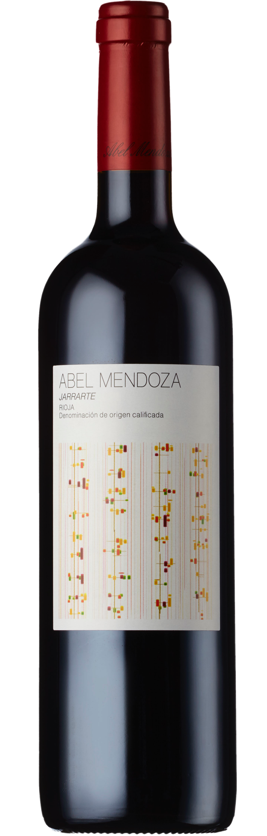
JARRARTE
This Jarrarte is an evolution of the Carbonic Maceration wine of the same name that came about in the early ‘90s when Abel and Maite introduced barrel aging to their winemaking.
“Jarrarte” is the name of an area next to the river that flows through San Vicente de la Sonsierra in Rioja. The area once belonged to the kingdom of Navarre, and the word has roots in the Basque language. “Arte” (between) and “Jarra” (stones). This is an homage to the soils of the region which are very stony and alluvial.
The grapes for this wine come from different plots, all roughly 35 - 45 years old. Each parcel is chosen for the blend based on its particular vintage characteristics. The fruit is sorted, destemmed (but not crushed) and fermented in stainless steel tanks. After fermentation, the wine is pressed off the skins and placed in concrete tanks for malolactic fermentation.
After malo, the wine is racked into one part new French oak barrels and one part into the barrels that their white wines were in. Usually the proportion is 50/50, but it can go 60/40 depending on vintage. The wine ages in barrel for 12 - 13 months, depending on taste. It is then bottled and cellared for about 3 years before release.

Slide 18
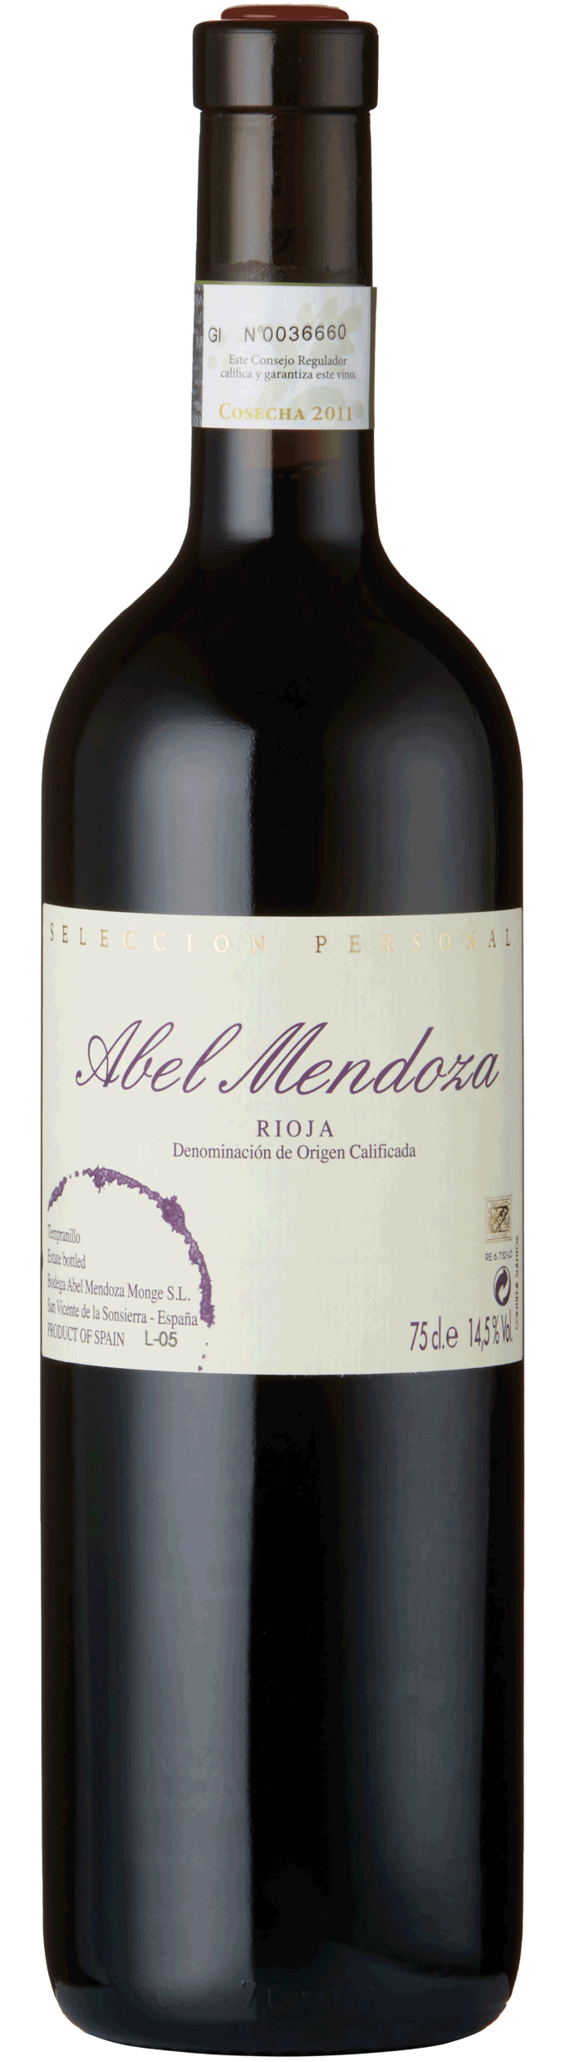
ABEL MENDOZA SELECCIÓN PERSONAL
The first vintage of this wine was in 1998 and it was the first time using “Abel Mendoza” as a brand on the wines. To put his own name on the bottle was considered more serious and Abel wanted the wine to be the best representation of his name as possible.
Abel and Maite have a plot of very old terraced vines next to the mountains, and the vineyard is roughly 70-ish years old. It was Abel's selected plot in 1998, the first vintage of the wine. Nowadays, the wine is made from the best plot based on vintage variation. Usually it's the same plot, but every now and then it varies. If the decision is to use another plot, the vineyards have to be at least 50 years old for this wine. They believe the “experience" of the vines makes for excellent quality fruit.
The fruit is sorted, destemmed (but not crushed) and fermented in stainless steel tanks. It then goes into concrete tanks for malolactic fermentation and then into 100% new French oak barrels for 12 - 13 months, depending on tasting.

Slide 19
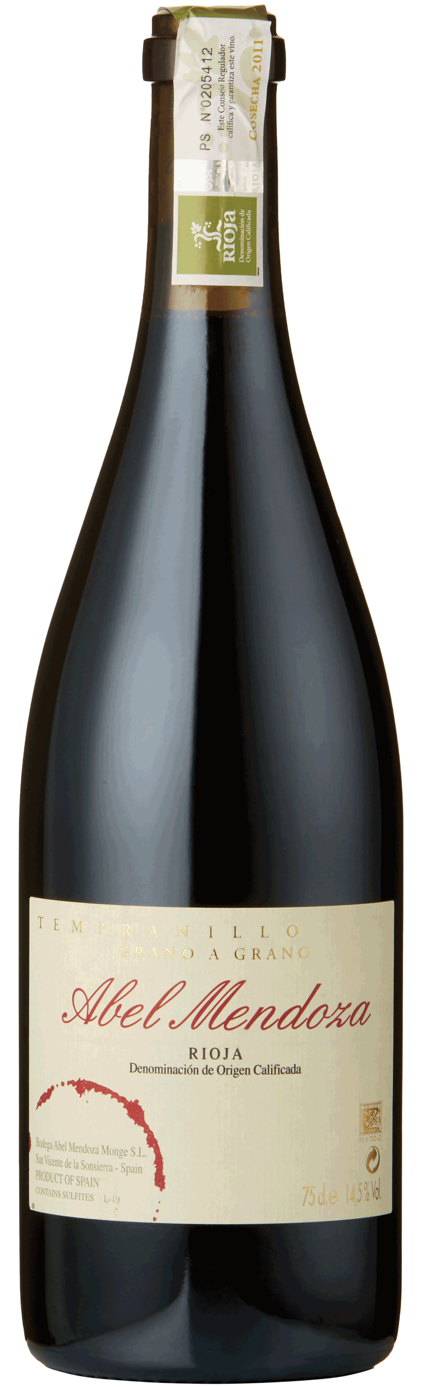
ABEL MENDOZA TEMPRANILLO
GRANO A GRANO
2003 was the birth year of both the Tempranillo Grano a Grano and the Graciano Grano a Grano. “Grano a Grano” literally means “Grape by Grape”. Each cluster of fruit is destemmed by hand. The idea is to separate the stems from the fruit and not to break the berries at all. During harvest, they invite some friends over and start destemming.
The aim is to get the fruitiness they get in the carbonic maceration Jarrarte into a more serious wine. Fermentation starts inside the berries and then the fruit is stomped by foot. The wine is made in small tanks of no more than 1,200 kgs.
After alcoholic fermentation, the skins are pressed into new 500 liter French oak barrels. Malolactic fermentation takes place in the barrel and the wine aged for 18 months before being bottled.

Slide 21
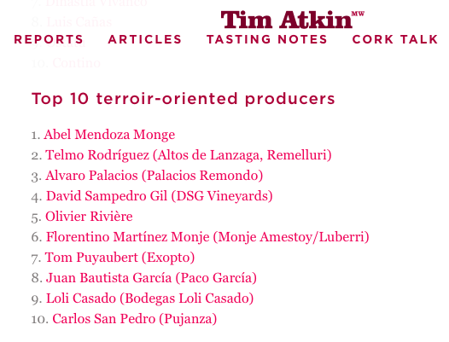

Slide 22
¡SALUD!
Abel Mendoza & Maite Fernández
(Bodega Abel Mendoza Monge, S.L.)
Imported by Marquee Selections
www.marqueewines.com
Bryce Gillespie
bryce@marqueewines.com
503.313.9180

